Slide 1
Calming Blue

Slide 2
Introduction
Mental Illness is one of the biggest challenges that students are facing today.
Calming Blue is a platform designed to ease this pain.
One check-in, one game, one resource, and one step at a time.

Slide 3
The Problem
Students often feel suffocated by the stress of everyday life and feel like there’s no one out there who cares. Upwards of 20% of U of C students report feeling like this.
As a result of mental illness, students are falling behind in school and often fall into depression.
Students are either unaware of the resources available to combat mental illness, or they don’t actively pursue these resources, or they don’t feel confident in seeking the help they need.
These students should have the right tools to overcome mental illness at their fingertips.

Slide 4
The Solution
Calming Blue has a simple, modular approach to combat mental illness:
A daily mood tracker
Logs and calendar tracking
Simple games
Resources and tools custom to each client

Slide 5
The Market
Post-secondary campuses
Clinical practices
The workplace
Local communities
Our global community

Slide 6
The Competitive Difference
Our mental health app helps students who are severely stressed alleviate their pain by connecting them with with the proper help available, unlike other products currently on the market which attempt to solve these pain points independently.
Our ‘killer edge’ is reaching out and filling a gap in digital outreach and e-Health strategies.
How? By pairing with professionals.

Slide 7

The Technology
Potential for a Utility patent
Secure & Anonymous
Relays critical data to the University
Easy to scale
Modular and customizable

Slide 8
The Approach to Market
First we will begin by gaining clinical and professional backing
Once we have proper backing we will begin approaching the UofC and start with experimental design testing on a small scale
Once we have gained a user base, we will grow the user base through trust, face to face marketing and through the University's resources
Finally, once we have grown within our first campus, we will have data to back up the usefulness of our product so we will begin to approach other institutions

Slide 9

The Revenue Model
Free for users
No Ads
Public Funding
Variable Leasing to Universities

Slide 10



Industry contacts and professional advice
Mental health expertise requires mental health professionals.
There is a need for clinical-grade, professionally-vetted technology.
How do we know this?
Massive drive for remote mental health and e-health initiatives in Canada and beyond.

Slide 11

Interest already expressed on campus
“This app fills an important need in mental health care. Mood tracking gives us valuable information about patients outside of the clinic. This information can then help us better understand and treat students”.
Vivian Kwan, Doctoral Student Clinical Neuropsychology
Other interested parties include:
U of C Student Success Center
NOMADS Peer Support Group

Slide 12
What is the environment at U of C?
University of Calgary Mental Health Strategy - No digital component!
“In 2014, mental health was the second highest cause of short-term disability claims, next to musculoskeletal injuries, and was the number one leading cause of long-term disability claims.” - Campus Mental Health Strategy
Total cost of mental illness to the Canadian economy? $51 billion.

Slide 13
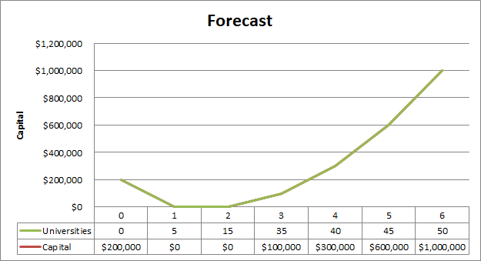
The Forecast
Use initial capital to break into the market
Goal of 15 universities by year 2
Increase in cost in the 3rd year to tap into new markets
Leasing ensures profit year over year

Slide 14
The Milestones
Year 0: Develop app, first University Sale
Year 0-1: Work with University to perfect app; sell to 5 Universities
Year 1-2: Reach 15 Canadian Universities
Yeah 2-4: Capture Canadian Market; Start developing into the United States
Year 3-5: Develop app for international markets

Slide 15
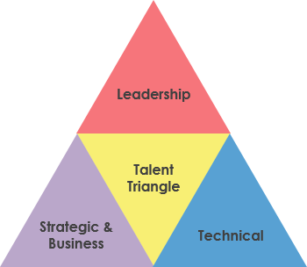
Our Team
James Raleigh - Founder, lead developer
Emily Chow - Security and interface design
Nik Lam - Games research and development
Kevin Fallwell - Market research and manager
Omar Abdulbaki - Accounting and investor relations
Robert Szustakowski - Operations and customer relations
We need industry partners!

Slide 16
The Ask
Raising a total of $500,000 for development cost: Covers first two years: rent, power, developer costs
Returns after the 4th year
Venture capitalists, angel investors, mental health professionals (sweat equity)

